Slide 1
Society Management System
Submitted by
Vaibhavi A. Shelar Roll No. 1213
Vrushali A. Mohite Roll No. 1217

Slide 2
Introduction
Scopes
Problem Statement
Aims & Objectives
Features
UML Diagram
Use case Diagram
Class Diagram
ScreenShots
Conclusion
Reference

Slide 3
Introduction
SMS are designed to provide utility to daily operations of society. This software helps maintains society Maintenance as well as cultural funds and other payments. Secretory can add Electricity billing, Water billing, security maintenance and also manage flat owner data. Then Flat owner need to add there family members and if owner have any issue then owner can complaint online through this system. Secretory can add events and cancel events, issue notice from notice board. Society Management System is the website portal to reduce conflicts among society members. The system has automated functionality for calculating monthly maintenance bill and member can view their bill status on their account.

Slide 4
Scope
This system allows secretory to add flat owners data, bills, events and issue notice. Flat owners allow add family members details and have any issue then apply online complaints.
The advancement in Information Technology and internet penetration has greatly enhanced various business processes and communication between society owners and their customers who are purchasing the flats. This Society Management System is developed to provide the following services:
Enhance Business Processes
Online Society Management
Monthly Bill generation

Slide 5
Problem Statement
Existing system for a society is based on our traditional way keeping records and details on paper and registers. This System Provide for Society maintenance. It help to manage daily society operations online using SMS. It is hard to manage all the society system with pen and paper. It gets really hard to maintain the records and then keep track of past records. Hence this system is proposed to overcome the flaws of the existing system and giving power to the admin of the society so that he/she will be able to manage the society easily.

Slide 6
Aims & Objectives
To produce a web-based system that allow the admin to add Society Details and provide functionalities to its role.
To ease flat owners by providing different functionalities to it.
To ease society’s secretary to help him in his work to add and track maintenance work efficiently.

Slide 7
Features
Managing details of flat Owners
Billing Management
Events Managing
Complaint Management
Share Announcement
Security Managements

Slide 8
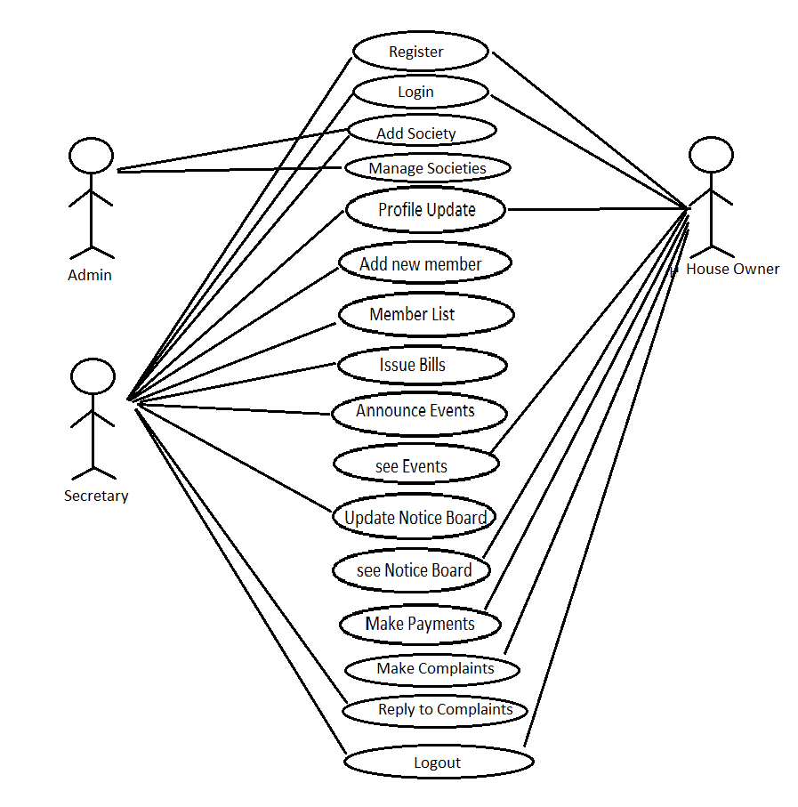
UML Diagrams
Use Case Diagram

Slide 9
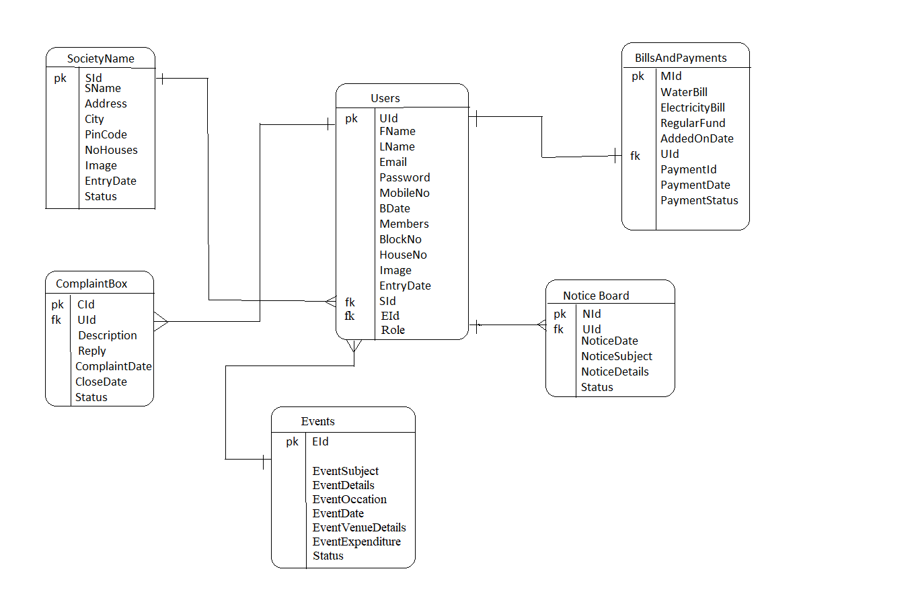
Class Diagram:

Slide 10
Screen Shots:
Home Page
Login Page
Registration Page
Add Society Page
List of Society Page
Add Events and list all events
Add noticeBoard and list all notices
About us page
Contact us page

Slide 11
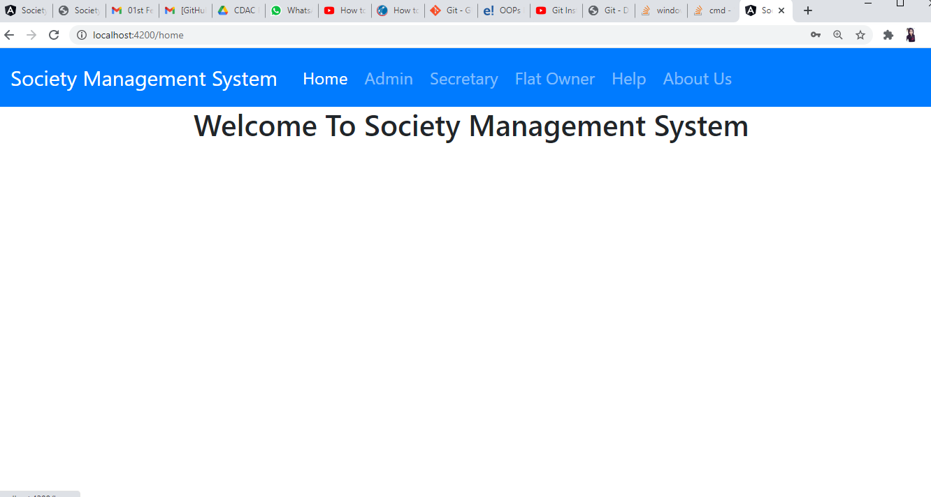

Slide 12
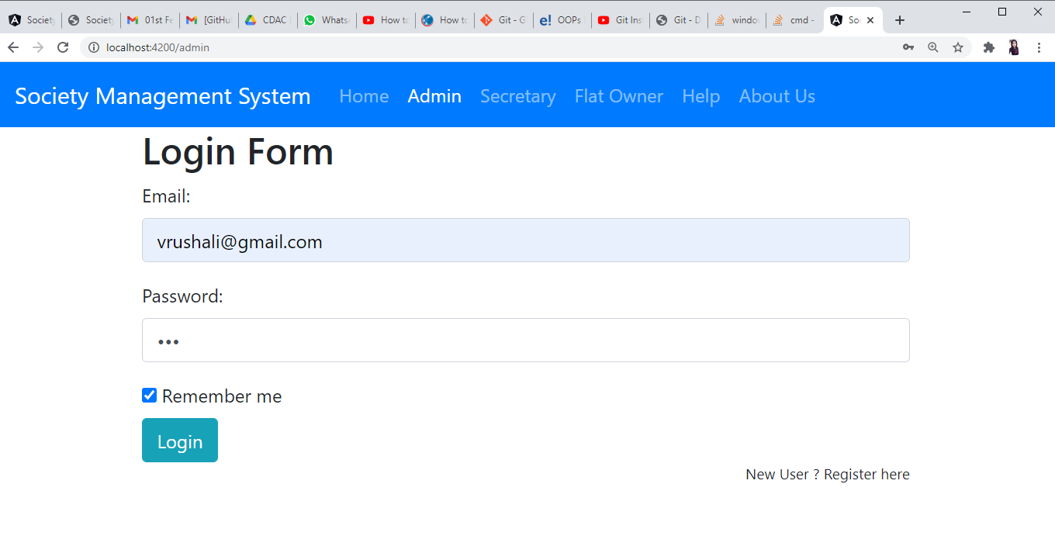

Slide 13
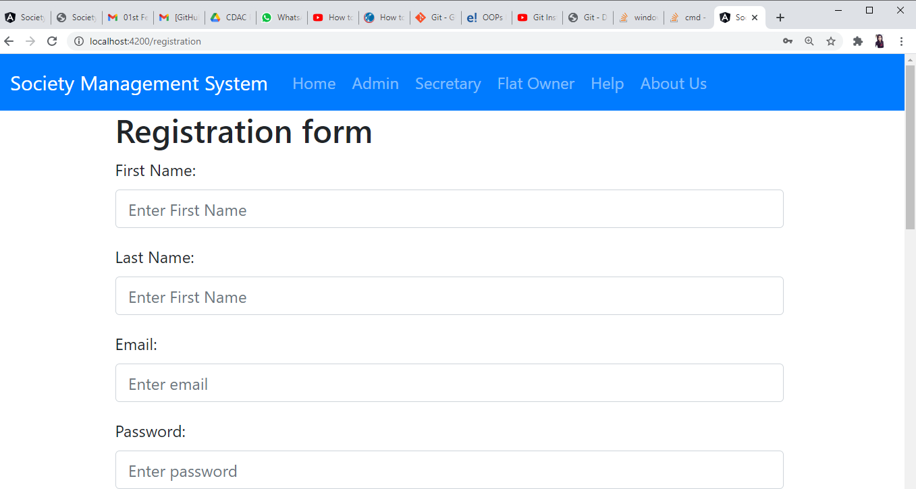

Slide 14
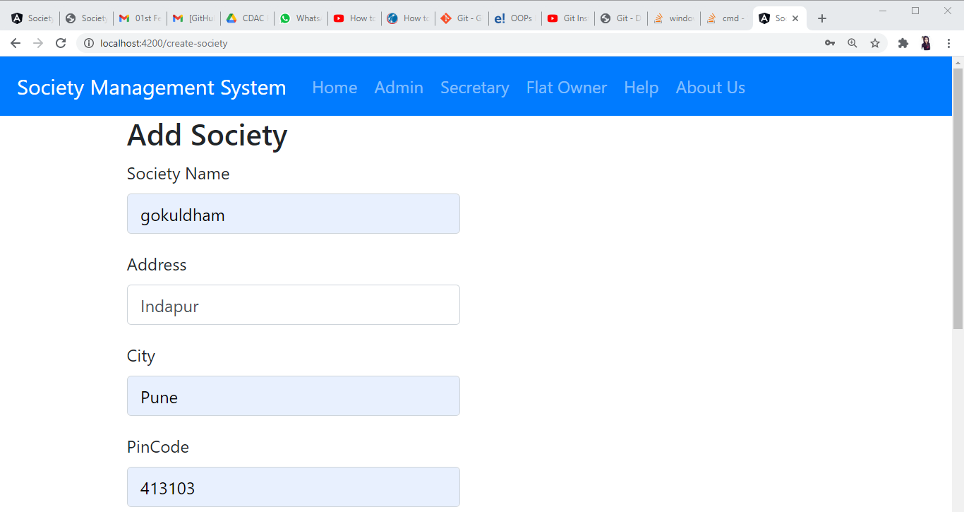

Slide 15
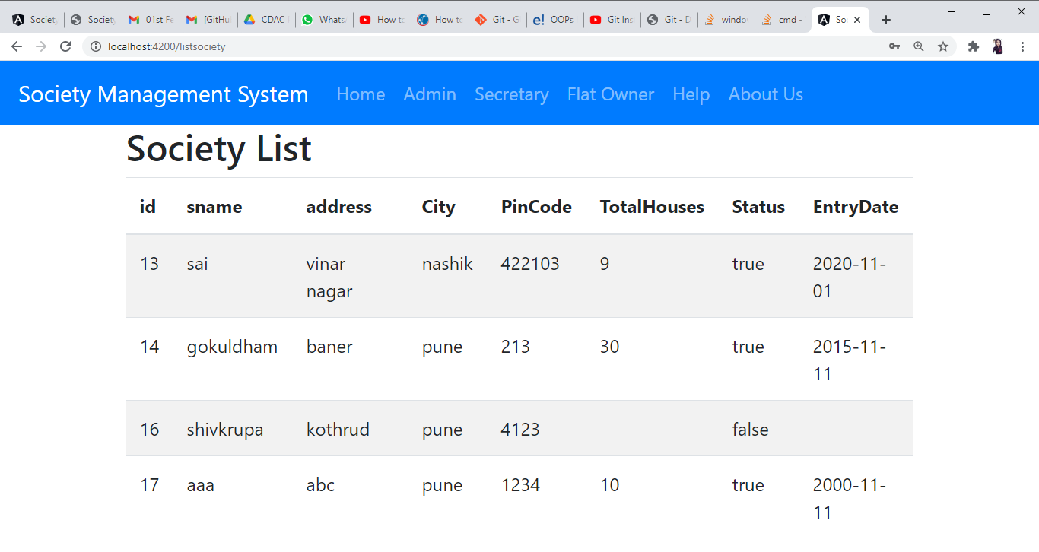

Slide 16
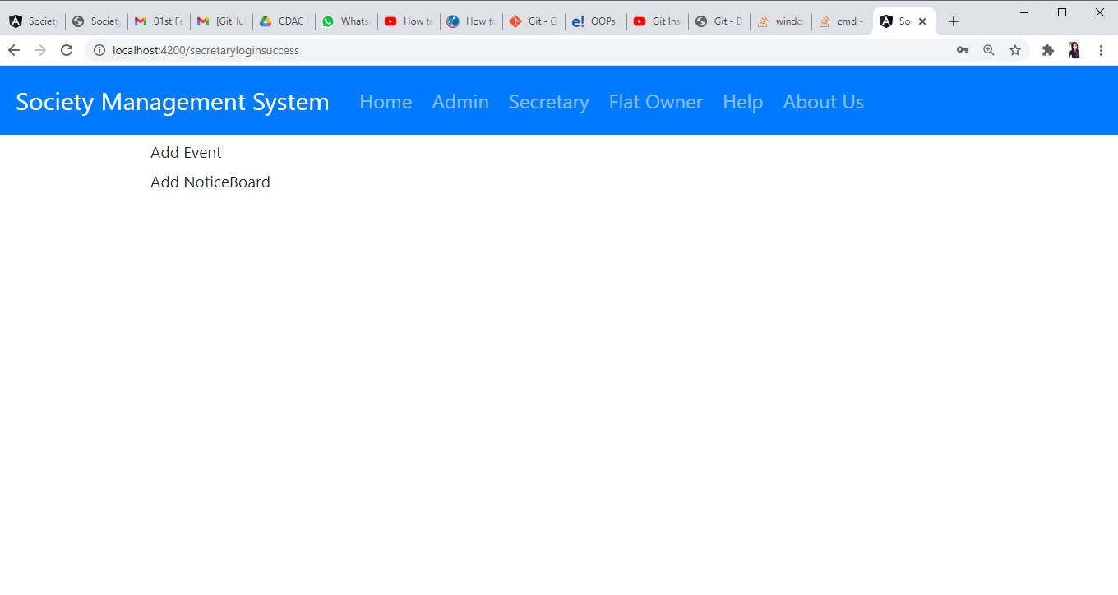

Slide 17
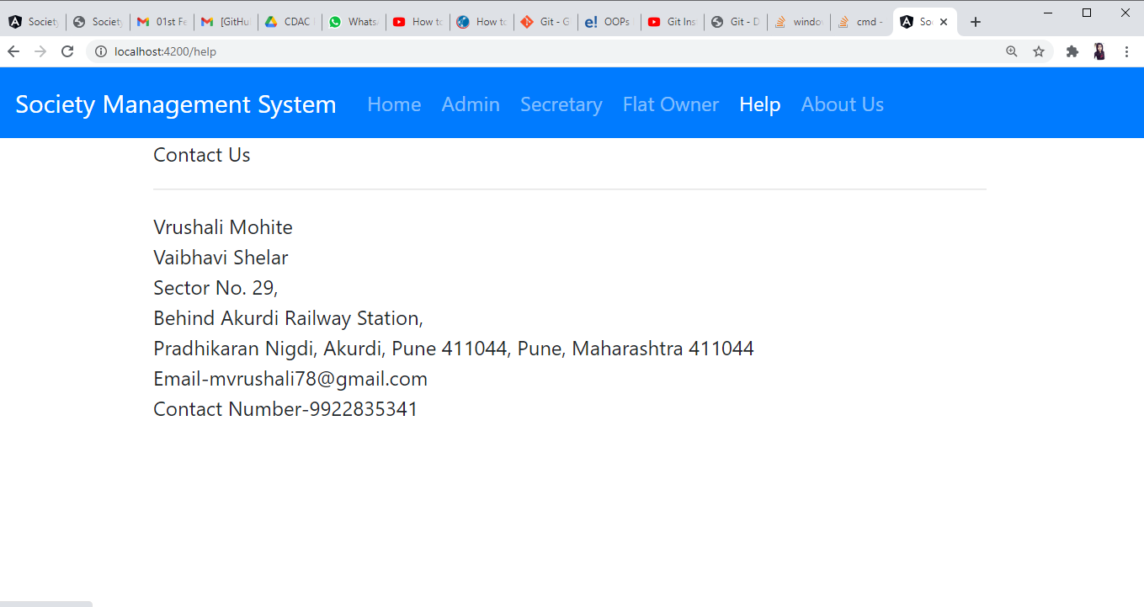

Slide 18
Conclusion
Society management system puts forth the actual working of a society. Administration, management, payment calculation, complaint Management, Event Management, Notice Generating etc. similar to a society are the key features of our project. User can access services and functionalities from the society anywhere and anytime for their own comfort.

Slide 19
References
Maharashtra Co-operative Housing Societies Act; [MCS Act] 1960.
“Reserve Funds” means the funds constituted under the provisions of section 66(1) of the Act and “Bye law” No. 12 (i).
“Repairs and Maintenance Funds” means the fund constituted under the Bye Law No. 13(a).
‟Sinking Funds” means the funds constituted under the Bye Law No. 13(c).

Slide 20
Thank You

